Slide 1
GIVE HOPE TO REFUGEE MOMS AND THEIR LITTLE ONES
How to Create Your Fundraiser Pages

Slide 2
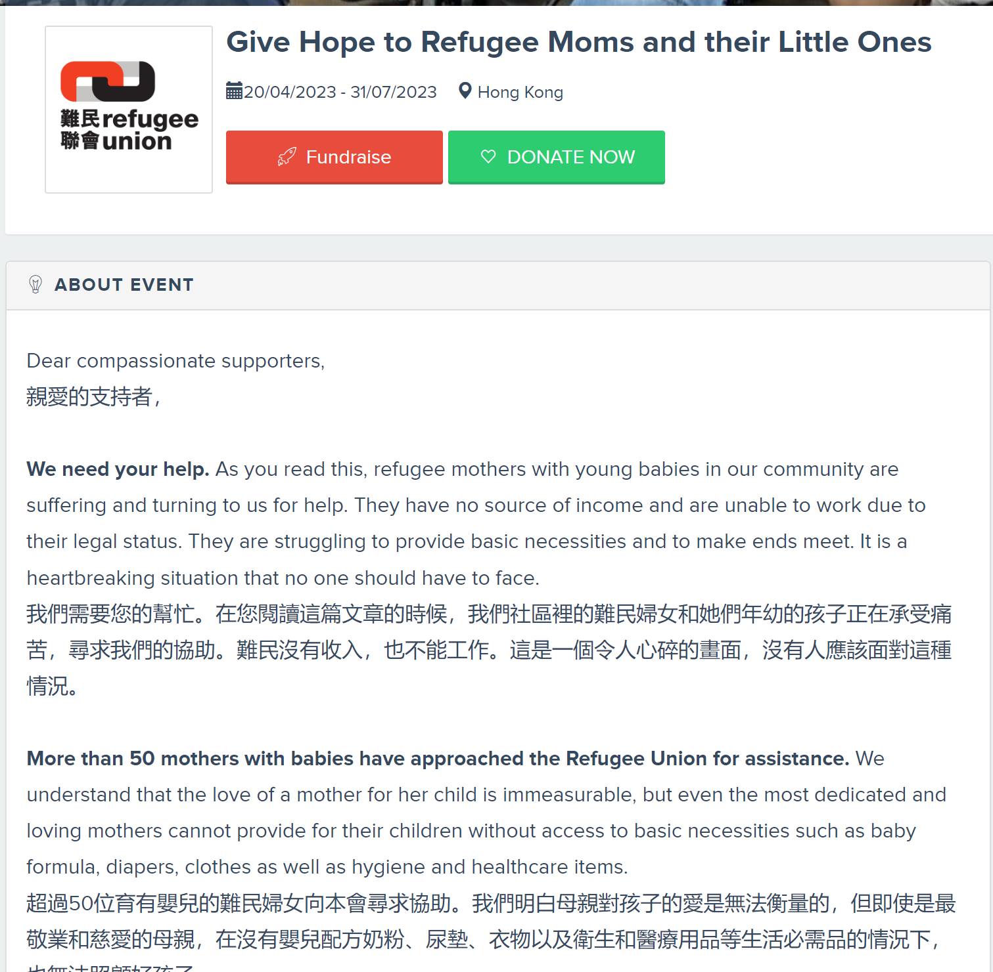
Start by accessing the hyperlink provided below and clicking on “Fundraise”
https://www.simplygiving.com/event/givehopetomoms

Slide 3
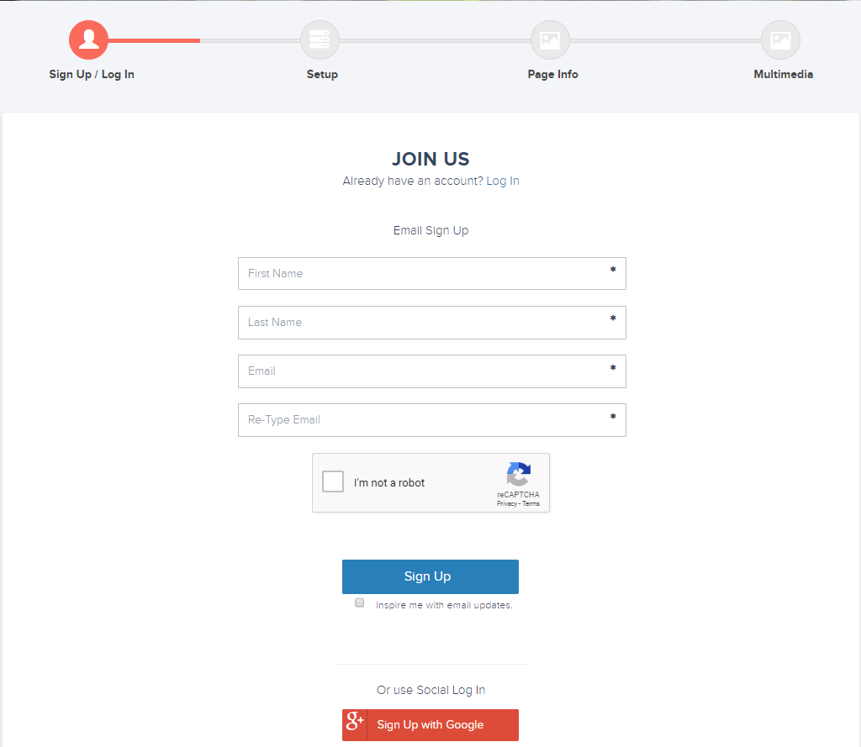
1. Login with your credentials if you are a returning user
2. Otherwise, sign up for a new account.
3. Alternatively, to simplify the login in process, you can sign up with your google account

Slide 4
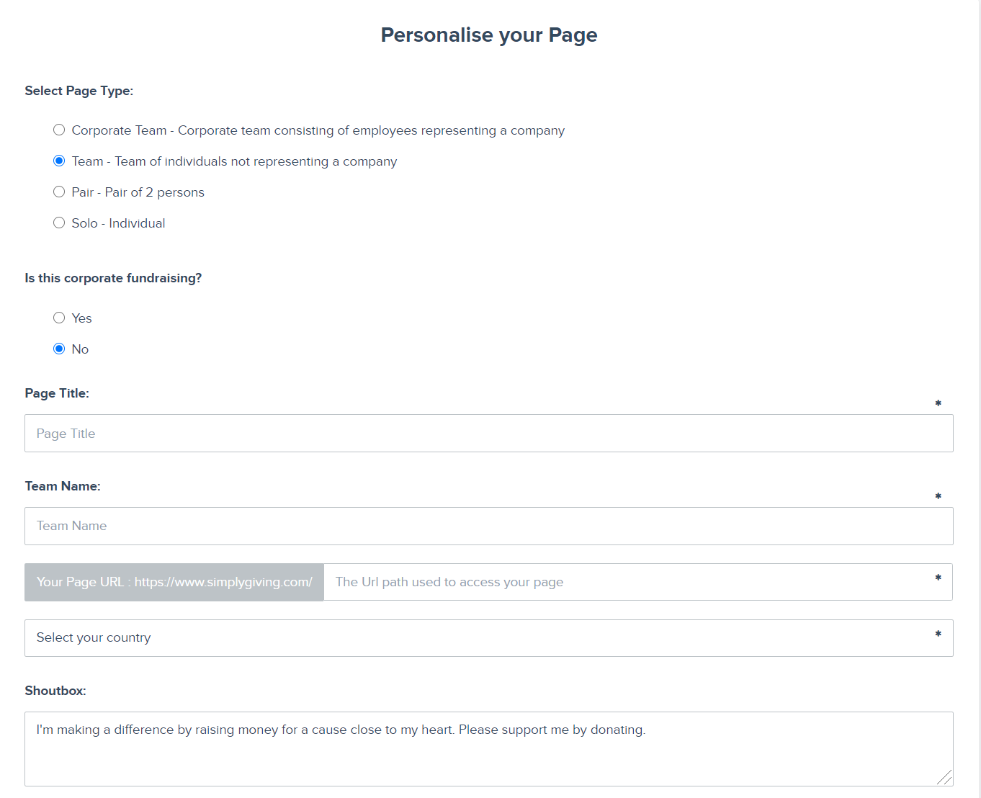
Personalise your page by filling in the required fields.
Tell the world your story and how much you plan to raise.
Your story is important to appeal to people who want to support you. Share why the campaign is an important cause for you!
Choose a memorable URL
You can write over this

Slide 5
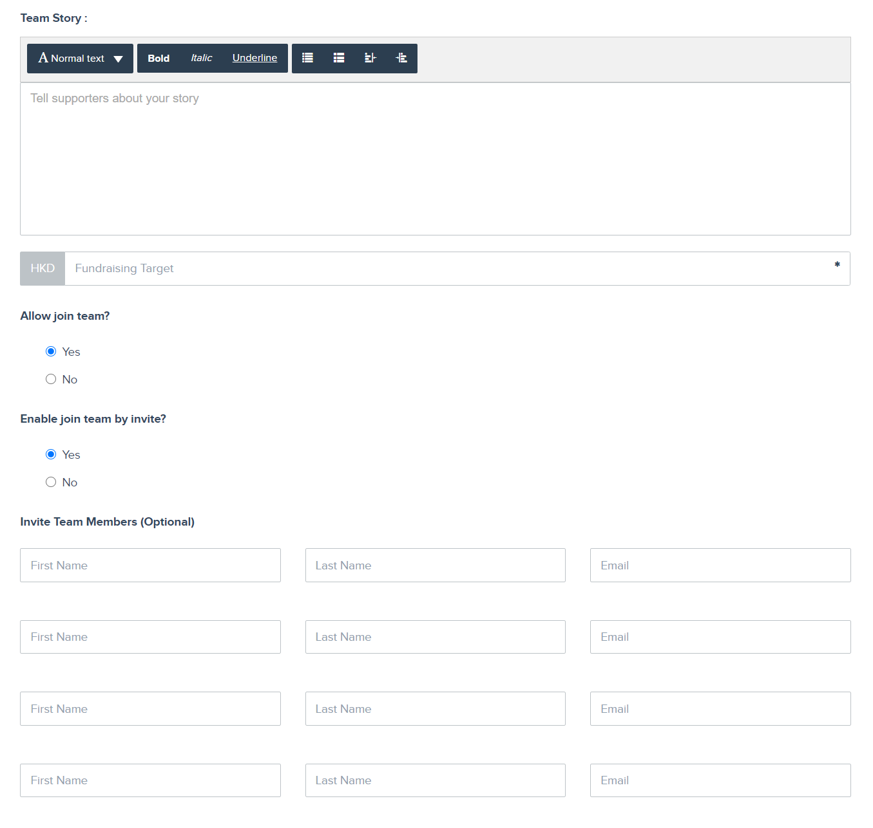
Personalise your page by filling in the required fields.
Set a target that is slightly challenging but achievable. This will drive you and your supporters to reach your goal.
Click Yes, if you want team members to create their own pages.
Or click No if your team is sharing the same page
Click No
This section will only appear if you have clicked on creating a “Team” or “Corporate Team” page

Slide 6
Final touches
Make your page more personalised and engaging by adding photos and videos.
Once you are done, click finish at the bottom right corner.

Slide 7
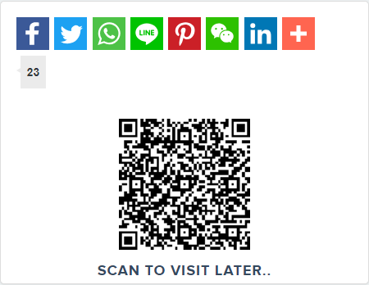
Help raise awareness and reach more people by sharing your page
Know others who might be interested? Personalised emails and Whatsapp messages are the most effective for conversion! Sharing on social media will help raise awareness.
Your page’s unique QR code will be here

Slide 8
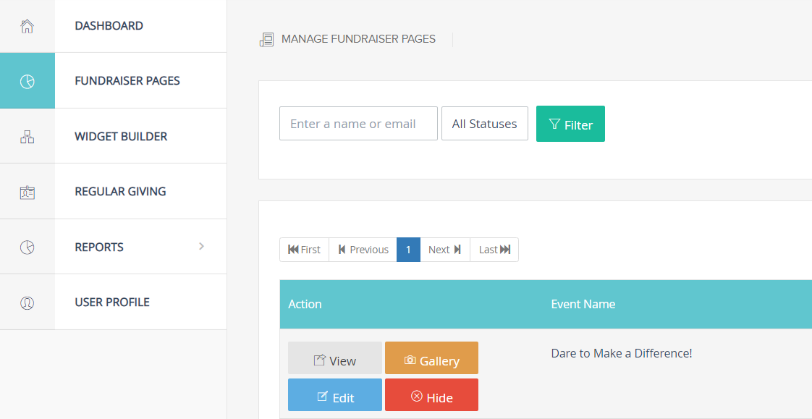
Editing your page
1. Login to your user account.
2. Enter the dashboard and click on charity fundraising.
3. Look for your personalised fundraising page and click edit.

Slide 9
Fundraising Tips
#1 Get Personal and Creative
On your SimplyGiving page, be specific about your fundraising goals and tell your friends and family why you care about the cause and charity. If you are volunteering at Refugee Union, share your personal story and experience. It is a powerful way of raising awareness for the charity.
Get Creative! A theme makes a campaign more meaningful, interesting and fun. Here are some suggestions:
Donate your Birthday. Ask friends and family to contribute to your birthday wish by making a donation, in lieu of presents.
Do a Personal Challenge. Are you running a marathon? Make that more meaningful by fundraising for a cause.
Do a Dare to Fundraise (but stay safe!)

Slide 10
Fundraising Tips
#2 Reach Out
Think about at least 15-20 people that you can approach and are most likely to donate to your campaign. Send them a personal email or WhatsApp message and ask them to support your cause. It is important to have a group of people that can help you kickstart the campaign. Ensure you include your SimplyGiving link in your emails and WhatsApp messages, so that they can make the donation easily. More than 70% of the donors on SimplyGiving donate using their mobile devices, so it's real easy to donate on the go!
#3 Go Social
If you have a social media account, post stories of your Fundraising experience. Social media is a great tool to raise awareness for the cause. On SimplyGiving, every social media share will bring in an average of 63 views to the campaign page. Ask your network to help you share the campaign page too. Always remember to post your unique SimplyGiving link.

Slide 11
Fundraising Tips
#4 Integrate
Integrate your messaging by syncing the timings of your personal email/Whatsapp outreach and social media postings. This helps your message become top of mind to your supporters. And you need to share a few times, not just once! Sharing is caring.
#5 Appreciate
It is important to thank your donors. This goes a long way to brightening someone's day and making them feel appreciated!

Slide 12
Thank you for your support! Every dollar raised makes a difference.
Contact us at: hello@simplygiving.com for page-related troubleshooting

